Slide 1
PhonePe Digital Payments Case Study
Analyzing Transactions, User Behavior & Demographics Using Python and Excel
Presented by: Disha Purohit

Slide 2
Objective
To analyze PhonePe digital payments data and uncover:
Transaction trends over time
Device usage patterns across states
Demographic influence on digital adoption

Slide 3
Tools & Technologies
Programming: Python (Pandas, NumPy, Matplotlib, Seaborn)
Data Source: Multi-sheet Excel files
Platform: Jupyter Notebook

Slide 4
Data Overview
Transaction Data: Volumes and values across Indian districts/states
User Data: App usage behavior and activity
Device Info: Types of devices used for transactions
Demographics: District population and other socio-data
Data spans across multiple quarters and years

Slide 5
Data Loading & Preparation
Loaded Excel files using pd.read_excel()
Cleaned nulls and unified column formats
Converted dates and standard units
Merged all sheets into a master dataset

Slide 6
Exploratory Data Analysis
Summary statistics of transaction values and counts
Analyzed usage patterns across time and regions
Correlation checks between demographic data and usage metrics

Slide 7
Conclusion
Bar Charts: Top-performing states/districts
Line Plots: Quarterly transaction growth
Heatmaps: Device preferences by geography
Pie Charts: Transaction type distributions

Slide 8
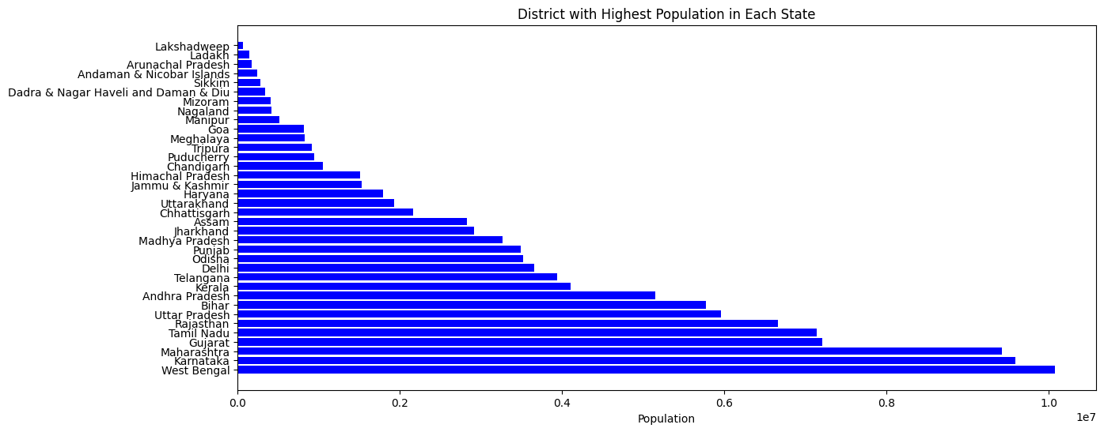
This chart represents the district with the highest population in each Indian state. The data is sorted from smallest to largest population, making it easy to see the demographic distribution across states.
States like West Bengal, Karnataka, and Maharashtra have districts with extremely high populations — highlighting potential hotspots for digital payment adoption.
Smaller states like Sikkim and Union Territories like Lakshadweep show significantly lower population density, which might influence the digital payment penetration and infrastructure requirements.

Slide 9
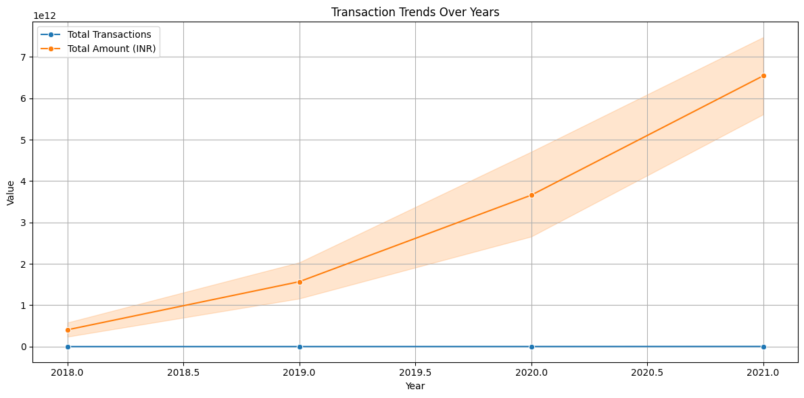

Slide 10
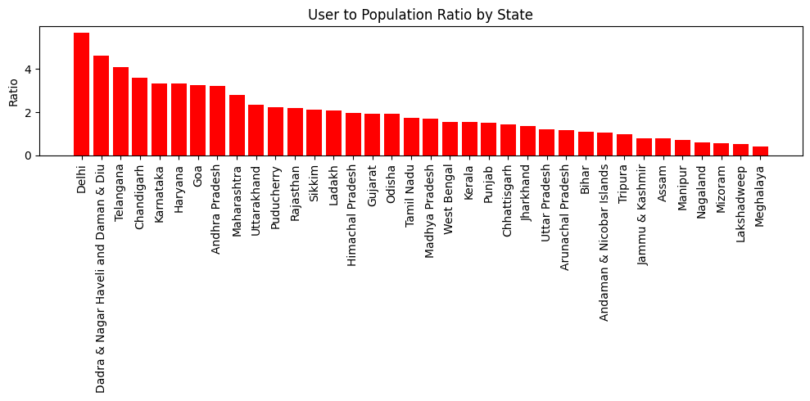

Slide 11
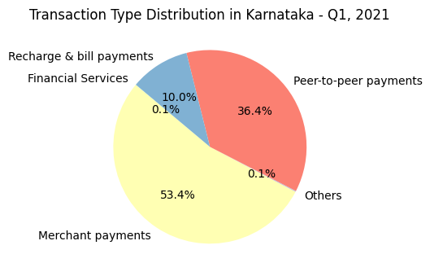

Slide 12
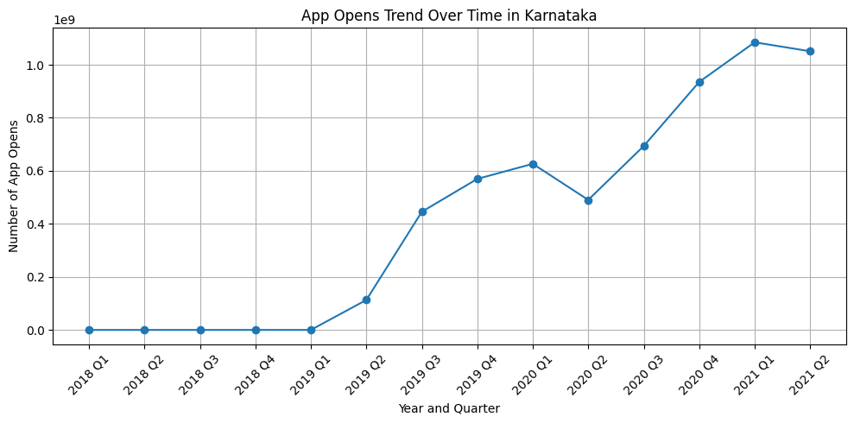

Slide 13
Insights
1. States like Maharashtra, Karnataka, and Tamil Nadu consistently lead in digital transactions.
2. Population density and number of registered users are positively correlated with transaction volume.
3. Device brands like Xiaomi and Samsung dominate rural usage, while Others (likely iOS/OnePlus) dominate urban states.
4. App usage and transactions both peaked post-2020, indicating digital transformation post-COVID.
5. Some states have a low user-to-population ratio—suggesting untapped digital potential.

Slide 14
Future Scope
Encourage onboarding in low user-to-population ratio states through localized campaigns.
Promote usage in medium-density districts showing below-average transaction rates.
Strengthen partnerships with mid-tier phone brands to enhance reach.

Slide 15
THANK YOU

